Slide 1
HISTORICAL THEOLOGY
Lesson Two
THE DEVELOPMENT OF THE BIBLE

Slide 2
CANON
Comes from a Greek word kanon meaning “a rule” or “a fixed reference point.”
The “canon of Scripture” refers to a limited and defined group of writings which are accepted as authoritative within the Christian church.
“Canonical” refers to a writing accepted to be within the canon.

Slide 3
THE ANCIENT CHURCH (100-600)
THE CHURCH FATHERS (100-150).
a) The OT was authoritative.
b) Christ and the apostles.
c) Tradition was authoritative.

Slide 4
“Tradition” in the NT
(from Latin “traditio” = “handing down” or “handing over”)
1. Negative sense: “tradition of the elders” (Mt. 15:2); “traditions of men” (Mk. 7:8; Col. 2:8).
2. Positive sense = apostolic teachings:
1Cor. 11:2 Now I praise you because you remember me in everything and hold firmly to the traditions, just as I delivered them to you.
2Th. 2:15 So Brethren, stand firm and hold to the traditions which you were taught, whether by word of mouth or by letter from us.
2Th. 3:6 Now we command you, brethren, in the name of our Lord Jesus Christ, that you keep away from every brother who leads an unruly life and not according to the tradition which you received from us.

Slide 5
THE ANCIENT CHURCH (100-600)
THE CHURCH FATHERS (100-150).
a) The OT was authoritative.
b) Christ and the apostles.
c) Tradition was authoritative.
d) Leadership was authoritative.

Slide 6
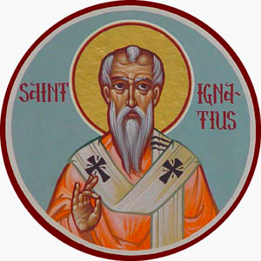
His writings expressed in many ways a shift from a plurality of leadership to the emergence of a single leader in each of the churches, the pastor/bishop.
Ignatius of Antioch (c.35-c.107)
Student of apostle John

Slide 7
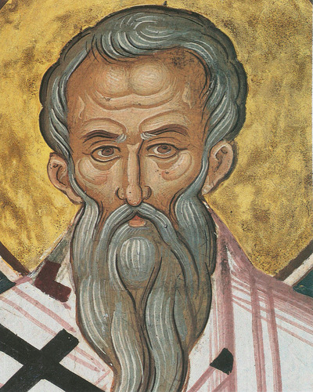
He advocated the concept of an apostolic succession in the churches.
Clement of Rome (d.101?)

Slide 8
Apostolic Succession in the Churches:
Continuation of the Gospel message
Lesser branches = elders
Major branches = apostles
Trunk = Christ
Root = God

Slide 9
2. THE APOLOGISTS (150-300). Defenders of the faith.
Opposition from religion: Gnosticism
Gnostics claimed to have unwritten apostolic traditions and some written sources to verify their teachings. This caused the church to reevaluate the issue of written and oral authority.

Slide 10
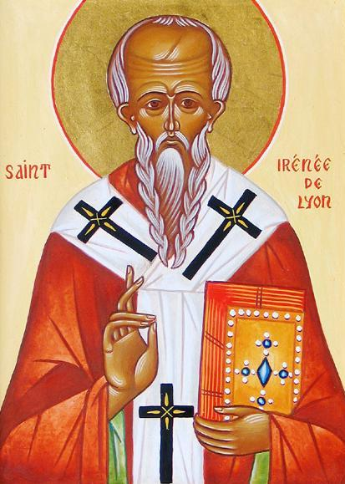
Value of Tradition
“Everyone who wishes to perceive the truth should consider the apostolic tradition, which has been made known in every church in the whole world. We are able to number those who are bishops appointed by the apostles, and their successors in the churches to the present day, who taught and knew nothing of such things as these people imagine
(ie, “secret” teachings of the Gnostics) . . .
The apostles have, as it were, deposited this truth in all its fullness in this depository, so that whoever wants to may draw from this water of life.”
IRENAEUS OF LYONS
(C.130-C.200)

Slide 11
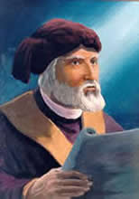
The Importance of Historical Continuity
Tertullian taught that orthodoxy depends upon the succession of apostolic teaching. The apostles received their doctrines directly from Christ and they in turn revealed them to the churches they founded. It is these apostolic churches that should set the standard for the faith since they faithfully preserve what was received from the apostles, who received it from Christ, who received it from God.
Tertullian
(c.160-c.225)

Slide 12
2. THE APOLOGISTS (150-300).
a) Opposition from religion: Gnosticism
b) Opposition from within:
(1) Marcionism – rejected OT, accepted Paul; 2nd cent.; dualism. God of OT not the God of the NT.
(2) Montanism – New Prophecies, revelations, ecstatic visions from H. S.; late 2nd Cent., condemned as heretical.
c) Opposition from the state.

Slide 13
EARLY CHURCH CANONS FROM THIS PERIOD:
All included the OT canon without the Apocrypha
1. The Muratorian canon (c.170) – N.T. inspired but did not include 1 & 2 Peter, 3 John, Hebrews, James.
2. Irenaeus (c.130-c.200) - except Philemon, James, 2 Peter, 2 and 3 John, and Revelation
3. Origen (c.185-c.254) - “disputed” books included Hebrews, 2 Peter (?), 2 & 3 John, the Epistle of Barnabas, the Shepherd of Hermas, the Didache, the Gospel of the Hebrews
By end of the second century a Canon began to emerge.

Slide 14
Key Criteria for the Canon
1. Apostolicity – written by an apostle or one close to an apostle.
2. Antiquity – recognized as Scripture by the church through the ages.
3. Spiritual elevation – was it edifying to the faith and lives of believers.

Slide 15
TRADITIONS CONTINUED TO BE IMPORTANT
BUT
TRADITION REFERRED TO THE ORAL PRESENTATION OR THE CREDAL STATEMENT OF THE ORTHODOX FAITH. THE VALIDITY OF THE GOSPEL MESSAGE LAY IN ITS CONFORMITY TO THE SCRIPTURES. THE ORAL WORD WAS AUTHORITATIVE BECAUSE IT WAS A FAITHFUL WITNESS TO THE WRITTEN WORD.

Slide 16
APOLOGISTS BELIEVED SCRIPTURE WAS THE WORD OF GOD IN WRITTEN FORM
Justin Martyr (c.100-c.165) – Scriptures were both verbally and plenary inspired.
Clement of Alexandria (c.150-c.215) – Inspiration was God using righteous men like a harp or lyre.
Athenagoras (2d. C.) – Prophets were lifted in ecstasy by the impulse of the Holy Spirit who used them like a flute player breathes into a flute.

Slide 17
“True knowledge is that which consists in the doctrine of the apostles . . . according to the succession of the bishops . . . without any forging of Scriptures . . . a lawful and diligent exposition in harmony with the Scriptures.” (Against Heresy 4:33)
IRENAEUS OF LYONS
(C.130-C.200)

Slide 18
Plurality of elders
One bishop

Slide 19
3. The Theologians (300-600).
1. Constantine accepted Christianity.
2. Council of Laodicea (363). (all but Revelation)
3. Athanasius (c.296-373). (complete NT; OT did not include Esther but did include Baruch)
4. Augustine of Hippo (354-430). (complete NT;
OT included Tobit, Judith, and 1 & 2 Maccabees)

Slide 20
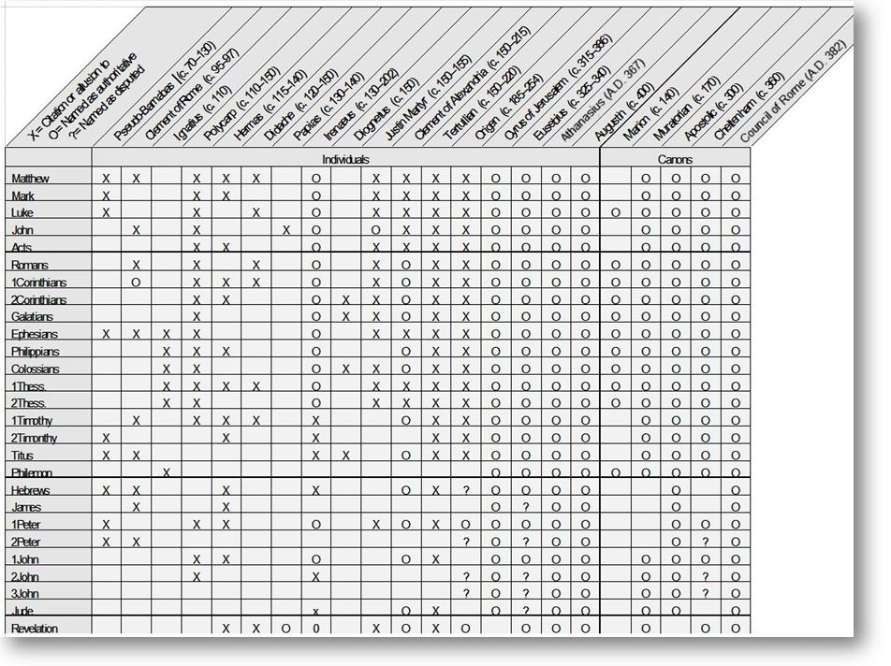

Slide 21
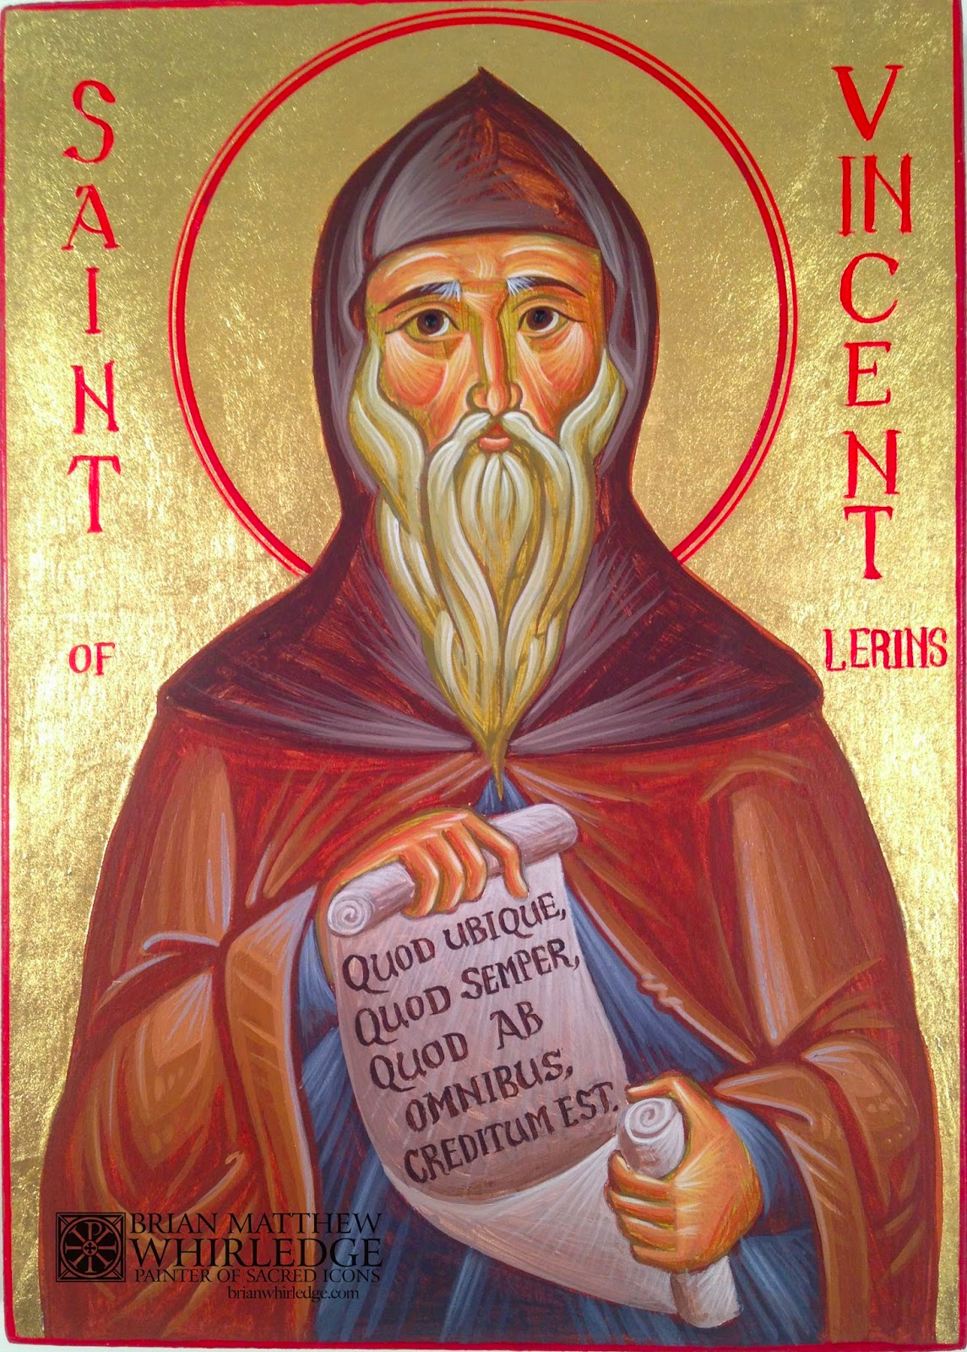
In order to identify heretical teachings, Vincent taught that the proper interpretation of Scripture must be that which has been accepted “everywhere, always, and by all people.” It must not be limited to a certain geographical region, a specific period of time, or a small group of people. His view became widely accepted as an essential antidote to heresy.
Vincent of Lerins
(died before 450)
Lerins = island south of France

Slide 22
The Medieval Church (600-1500)
Some of the Apocryphal books were still being included in the Roman Catholic Church which held to the Latin Vulgate. Some NT books were still doubted by some (Hebrews, 2 Peter, James). The canon was not considered to be an issue that warranted an ecumenical declaration.
The Renaissance (c.1300-1600) brought a renewed interest in the Hebrew and Greek Scriptures.

Slide 23
The Early Modern Church (1500-1750)
1. Roman Catholic Church. The Council of Trent (1545-63) accepted the Old Latin Vulgate as their Bible. 7 of the 15 Apocryphal books were accepted. Their view of “tradition” changed to include church customs and practices in addition to oral tradition that lined up with apostolic teachings. Tradition became an independent (and superior) authority. The Church controlled the interpretation of Scripture.
2. Protestant Reformed Church. Downplayed the role of tradition for two reasons. 1) church teachings often contradicted one another; 2) some doctrines contradicted the Scriptures directly, such as the that the sacraments were necessary for justification; or they added to the Word, like the invention of 5 other sacraments.

Slide 24
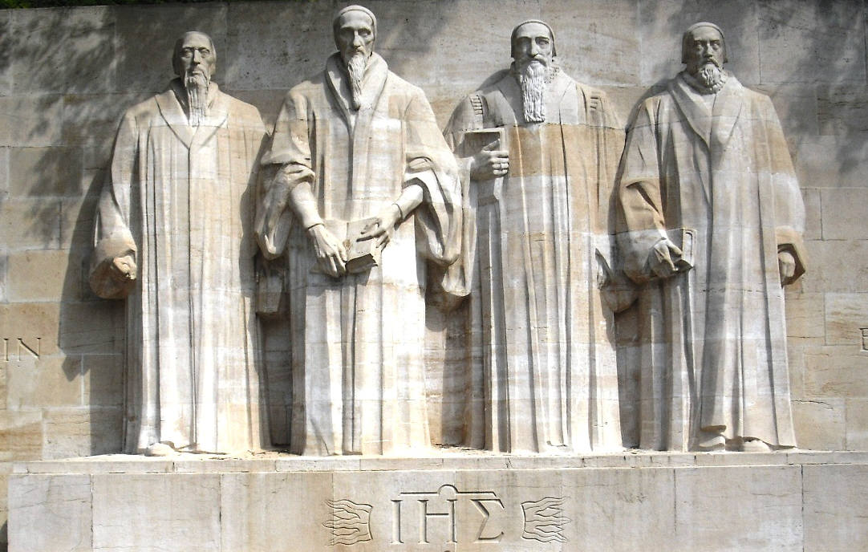
The Reformers adopted the Hebrew OT without the apocrypha rather than the Septuagint with the apocrypha. The apocrypha had historical and chronological errors and was not considered sound by the early church. Also, the NT should be based on the original Greek and not the poorly translated Latin Vulgate.

Slide 25
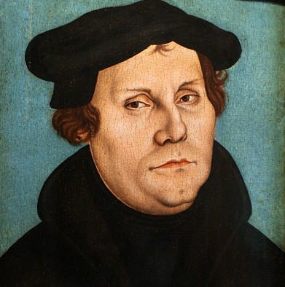
Based on the Greek word “metanoeo” –
When our Lord and Master Jesus Christ said, “Repent” (Mt. 4:17), he willed the entire life of believers to be one of repentance.
2. This word cannot be understood as referring to the sacrament of penance, that is, confession and satisfaction, as administered by the clergy.
Martin Luther
(1483-1546)
Ninty-five Theses, 1517

Slide 26
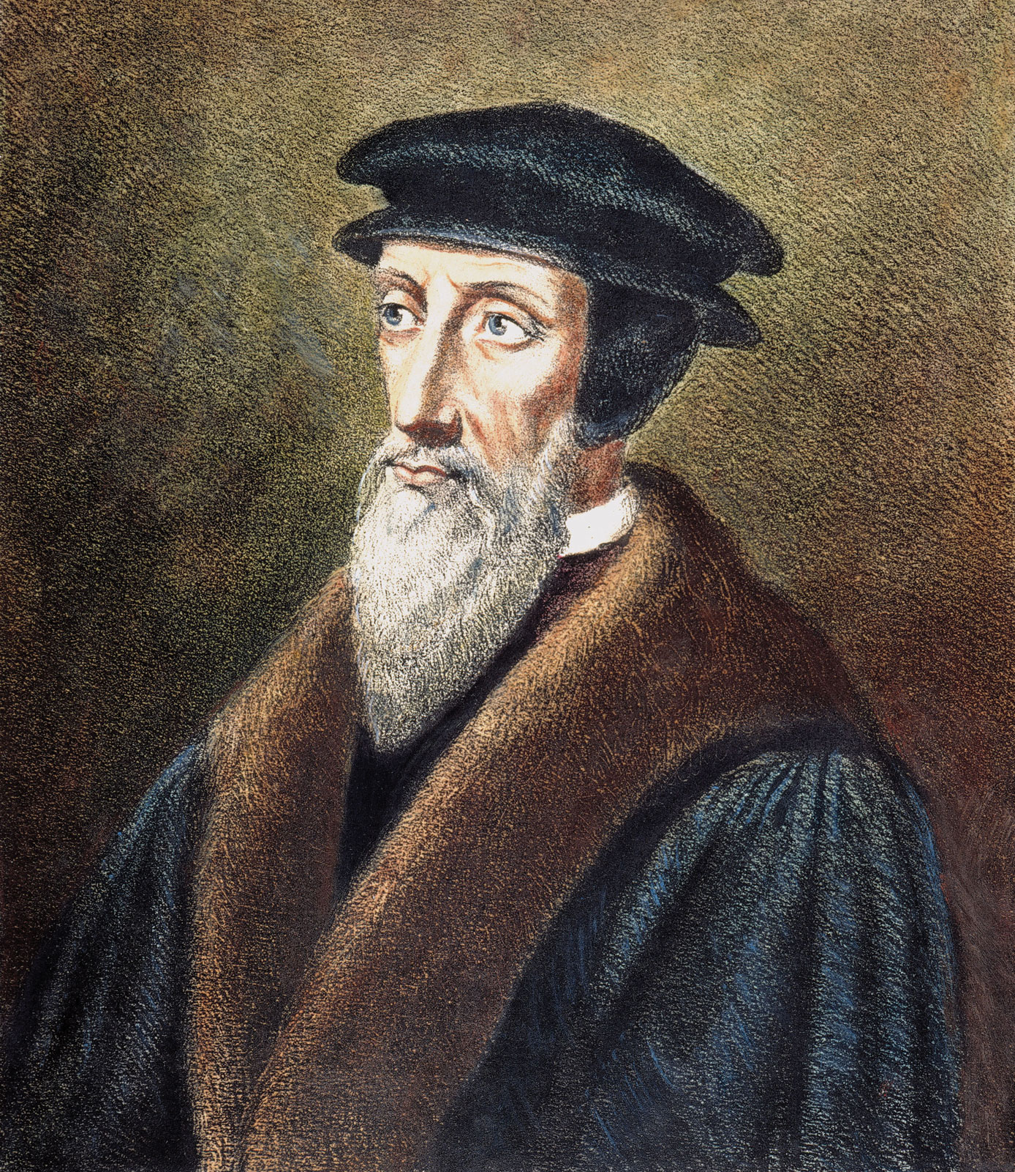
The church does NOT create or determine the canon of Scripture but merely recognizes and affirms the divinely inspired writings that God intended to be in the canon.
John Calvin
(1509-1564)

Slide 27
“Those whom the Holy Spirit has inwardly taught truly rest upon Scripture, and that Scripture indeed is self-authenticated . . . And the certainty it deserves with us, it attains by the testimony of the Spirit . . . Therefore, illumined by His power, we believe neither by our own nor by anyone else’s judgment that Scripture is from God . . . We affirm with utter certainty that it has flowed to us from the very mouth of God by the ministry of men.”
John Calvin
(1509-1564)

Slide 28
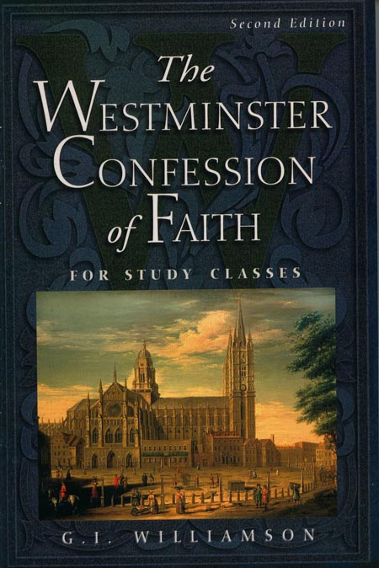
“Our full persuasion and assurance of the infallible truth and divine authority thereof, is from the inward work of the Holy Spirit, bearing witness by and with the Word in our hearts.”
(Westminster Confession, Ch. 1.5)
(1646)

Slide 29
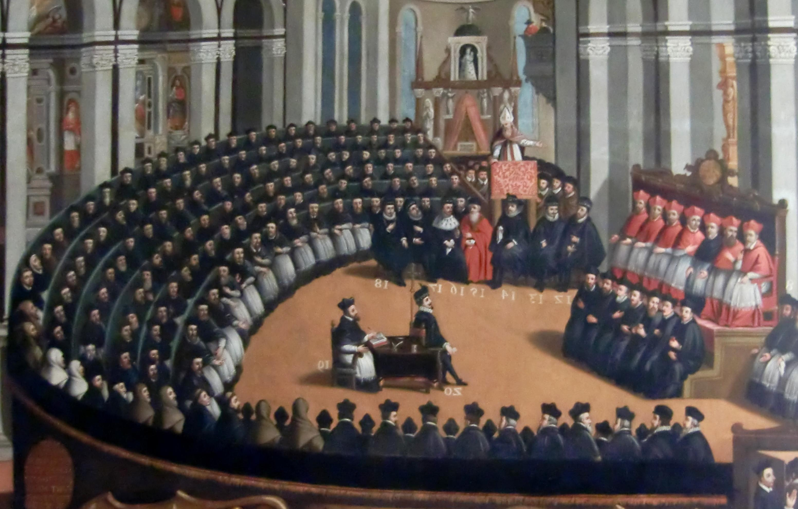
“If anyone does not receive as sacred and canonical these books (the Apocrypha) with all their parts, as they have been read in the Catholic Church as they are contained in the old Latin Vulgate edition, and knowingly and deliberately rejects the above mentioned traditions, let him be anathema [cursed].”
4th session, April 8, 1546
Roman Catholic Church
Council of Trent
(1545-63)

Slide 30
The Late Modern Church Influences (1750-Present)
1. The Renaissance. So-called birth of learning, humanism, “man is the measure of all things,” rejected both the authority of tradition and the Bible.
2. The Enlightenment (18th cent). Turn inward to find authority. Reason and scientific method were king.
3. Higher Criticism.

Slide 31
Higher Criticism
Higher Criticism treated the Bible like any other human book and accused it of having many errors (“to err is human”). The Bible and the “Word of God” were not the same. The development of the canon came to be viewed as a completely human action with no divine guidance in the process.

Slide 32
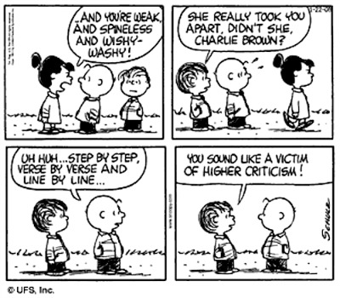
Notes:
Lucy, Charlie Brown, Linus.

Slide 33
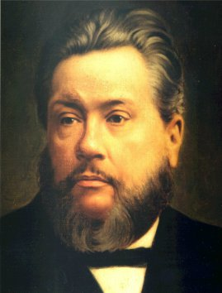
Charles Spurgeon and the Down-Grade Controversy (1887-88)
The “Down-Grade” in the Baptist Union denied the inspiration of the Bible, the deity of Christ, and justification by faith alone, etc.

Slide 34
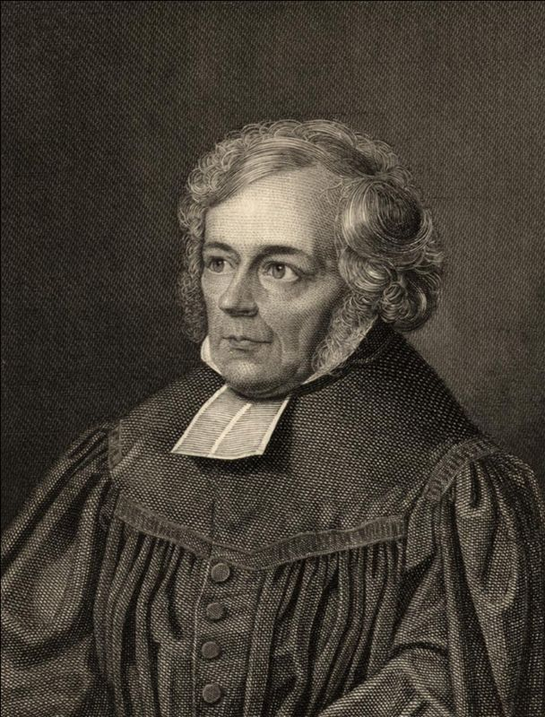
Tried to protect the Christian faith from the attacks of skeptics and materialists by placing the authority of Christianity in the inner self, a feeling of absolute dependence on God. Christian faith does not need a truthful, inspired Bible.
OT was not inspired and secondary in importance.
Friedrich Schleiermacher
FATHER OF MODERN LIBERALISM
(1768-1834)

Slide 35
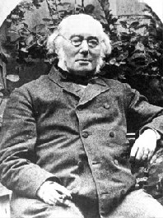
The Bible is NOT the revelation of God but contains it surrounded by much that is bad history, science, and morals. The revelation of God is enmeshed in mythology but somewhere in the Bible is the revelation of God.
Albrecht Ritschl
(1822-1889)

Slide 36
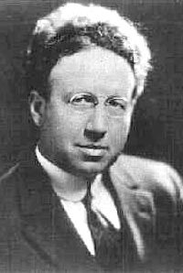
He rejected those parts of the Bible he found either morally or intellectually questionable and embraced the “real” Bible which he found by looking to Jesus, the window into God, because His morals were divine, and reflected the character of God. The Bible was a dung heap where in the manure and straw was the gleaming nuggets of truth.
Harry Emerson Fosdick (1878-1969)

Slide 37
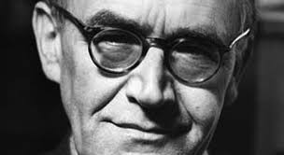
Karl Barth (1886-1968)
Professor of theology at Basel
The Word of God is not the Bible but an event, an encounter with the living Christ. The Bible is a witness to Christ and can become the Word of God. Thus the issue of inerrancy did not trouble Barth because the Bible was merely a means to revelation.

Slide 38
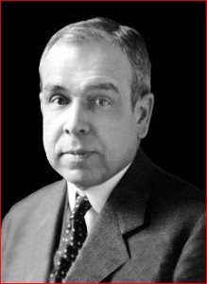
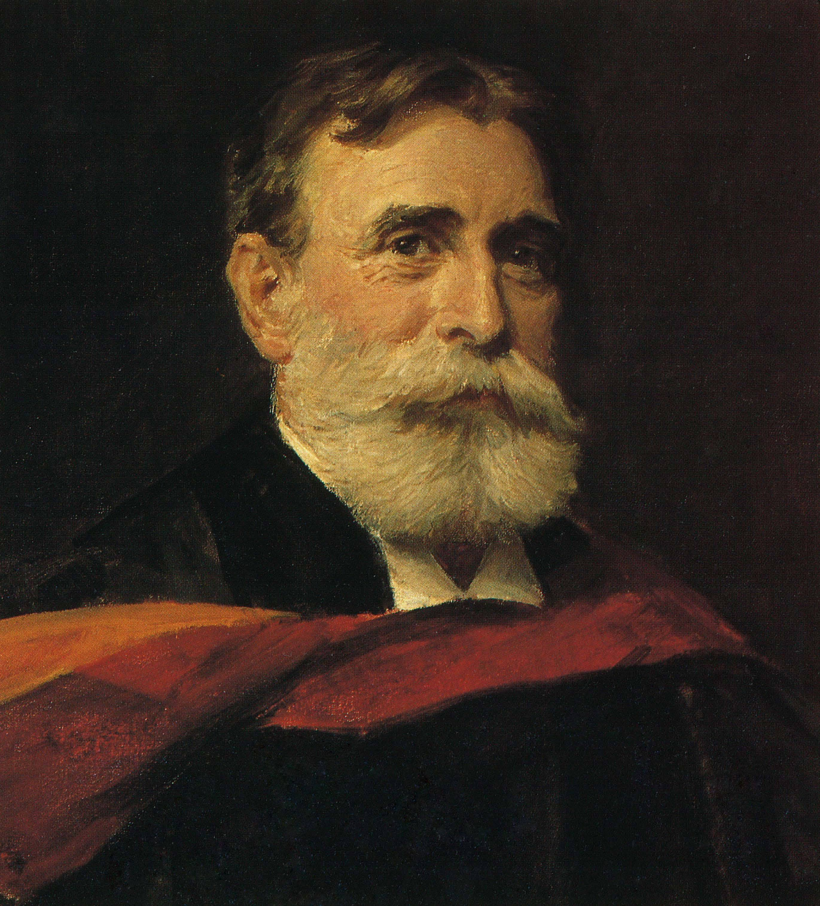
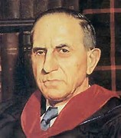
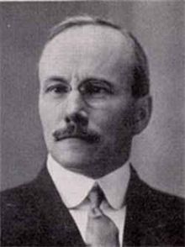
J. Gresham Machen
B. B. Warfield
John Murray
O. T. Allis

Slide 39
Sola Scriptura
“All Scripture is inspired by God and profitable for teaching, for reproof, for correction, for training in righteousness; so that the man of God may be adequate, equipped for every good work.”
2 Tim. 3:16-17

